Slide 1
Digital Portfolio
STUDENT NAME : Mythili Chandra.R
REGISTER NO AND NMID: asunm1451222407506
DEPARTMENT : BSc Computer science
COLLEGE : Mahalashmi Women’s college of Arts and
science(Madras university)

Slide 2
DIGITAL PORTFOLIO

Slide 3


AGENDA
Problem Statement
Project Overview
End Users
Tools and Technologies
Portfolio design and Layout
Features and Functionality
Results and Screenshots
Conclusion
Github Link
3/21/2024 Annual Review

Slide 4

PROBLEM STATEMENT
* Fresh graduates and students often find it difficult to present their skills, projects, and achievements in a structured way.
* Recruiters have limited time to evaluate candidates, so a portfolio should make it easy to understand a student’s strengths at a glance.
* A traditional resume cannot fully showcase a person’s abilities such as creativity, coding projects, certifications or internships.

Slide 5

PROJECT OVERVIEW
This project is about creating a personal Digital Portfolio that acts as my online professional identity.
It is designed to showcase my academic background, technical skills, projects, certifications and achievements in one place
The portfolio has a simple yet attractive layout, allowing users to navigate easily through different sections.
The main objective is to help me in internships, placements, competitions by presenting my work in a professional manner.

Slide 6

WHO ARE THE END USERS?
RECRUITERS & HIRING MANAGERS
MENTORS AND FACULTY MEMEBERS
PEERS AND COLLOBORATORS
GENERAL/ ONLINE VIEWERS
PERSONAL USE

Slide 7

TOOLS AND TECHNIQUES
HTML: Used for structure and content of the portfolio .
CSS : Used for styling and layout .
For colors, fonts, spacing and responsive design.
JAVASCRIPT: Used for interactivity and functionality .

Slide 8
PORTFOLIO DESIGN AND LAYOUT
* Homepage : Contains name, picture and an simple introduction.
* About Section : A brief biography about my skills and strengths.
* Projects Section: Details about the projects with description.
* Contact Section : Email id and other social profiles.
* Navigation : A clean and user friendly menu for smooth movement .
8

Slide 9
FEATURES AND FUNCTIONALITY
* Fully Responsive design.
* Works on laptops, tablets and mobile phone.
* Contact and social links for easy communication.
* Simple navigation bar for quick access to all sections.

Slide 10
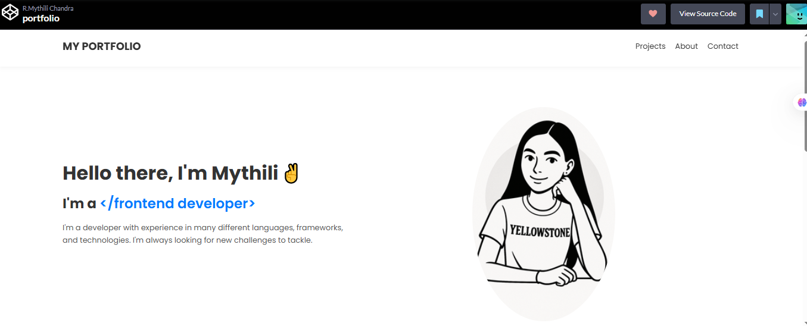

RESULTS AND SCREENSHOTS
3/21/2024 Annual Review
10

Slide 11
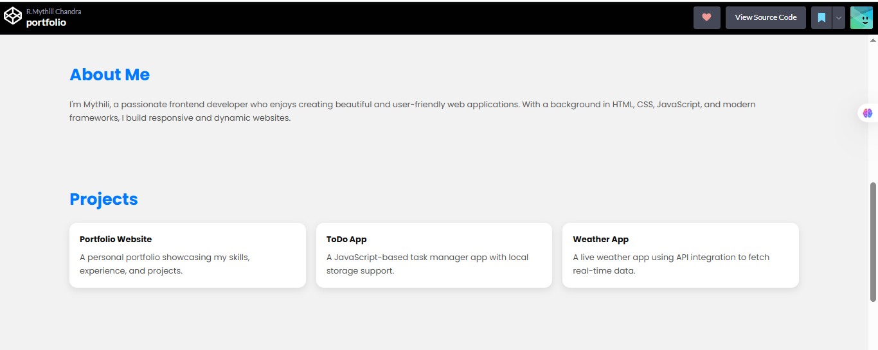
Screenshots

Slide 12
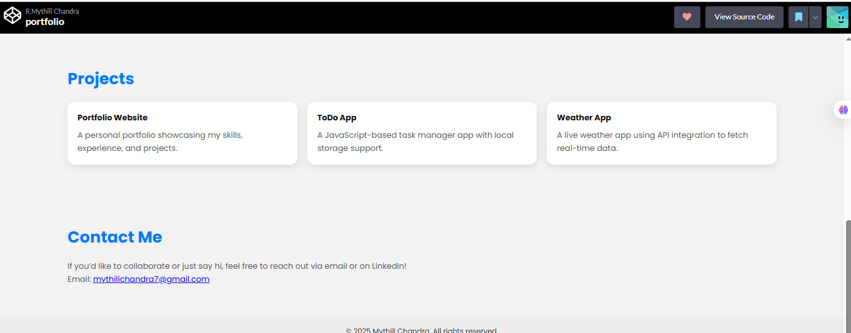
PROJECTS AND CONTACT

Slide 13
CONCLUSION
* The portfolio serves as a digital resume and a showcase of my work.
* It is easy to update, so I can keep adding new projects, certificates and my skills.
* In conclusion, this portfolio reflects my journey ,growth and readiness for future opportunities.
GITHUB:
* The entire source code of my portfolio is uploaded on Github.
* Link: https://codepen.io/RMythili-Chandra/pen/OPyEbGz.
13

